Slide 1
Benchmarking HPL and HPCG and beyond
Optimization & Performance Analysis on Heterogeneous Clusters
Notes:
Good morning, my name is Adam Fasulo and I wanted to present about two paper I recently wrote analyzing the scaling laws and performance analysis of HPL and HPCG and a little technical deep dive I did on the H100’s

Slide 2
The Two Benchmarks
HPL — Peak Compute Benchmark
Dense linear algebra (LU factorization)
Stresses compute pipelines and exposes synchronization costs through panel broadcasts.
HPCG — Realistic Memory-Bound Benchmark
Irregular access patterns
Dominated by SpMV
Stresses memory bandwidth & communication costs
Notes:
HPL is great for raw compute and HPCG is great for representing scientific workloads
Slide 3: A quick note about the history of HPL.
You have Jack Dongarra here on the left who started his career at Aragone national labs where he helped build LINPACK. Late 70’s came to ABQ to study under Clev Moler as his PHD student and later created the HPL benchmark on accident.
Point out license plate, turning award, and TOP 500 list.

Slide 3
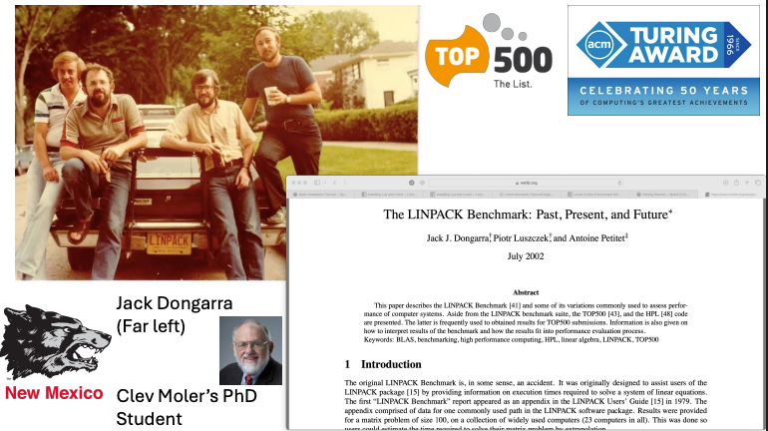
LINPACK
Notes:
A quick note about the history of HPL.
You have Jack Dongarra here on the left who started his career at Aragone national labs where he helped build LINPACK. Late 70’s came to ABQ to study under Clev Moler as his PHD student and later created the HPL benchmark on accident.
Point out license plate, turning award, and TOP 500 list.

Slide 4
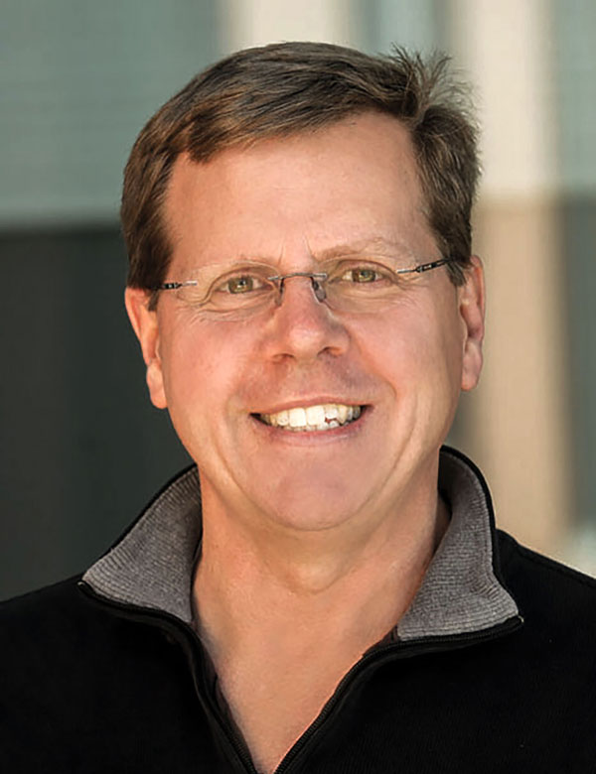

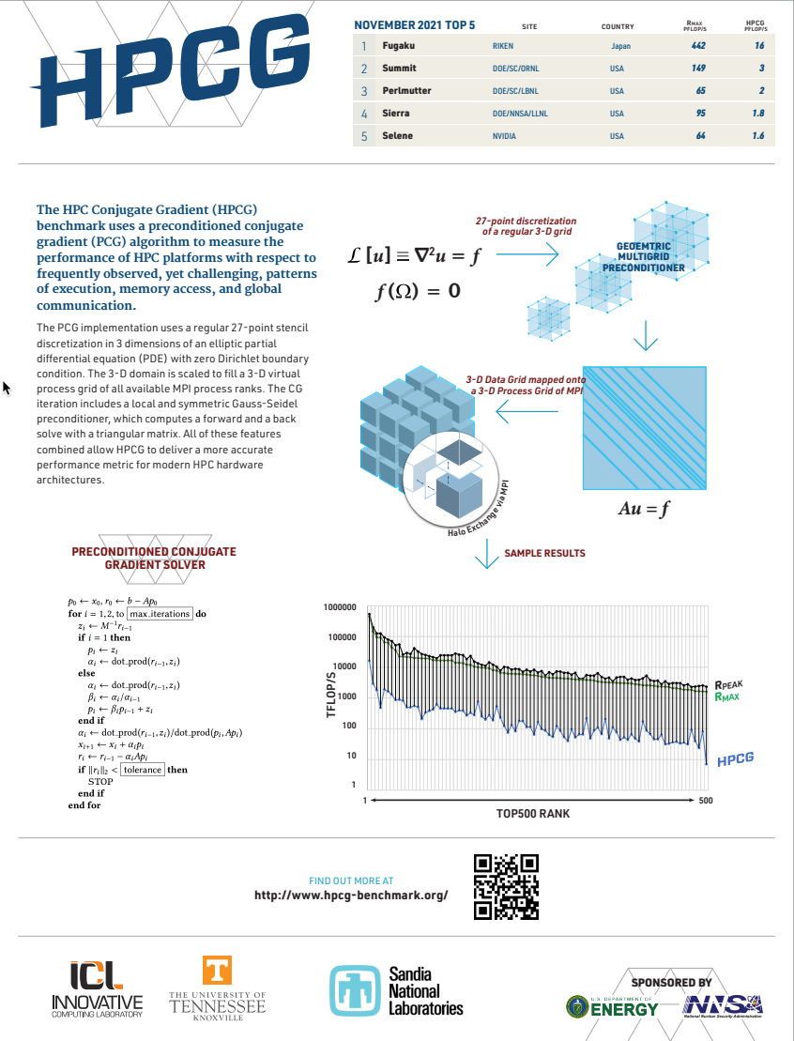


Michael Heroux
Jack Dongarra
Piotr Luszczek
Notes:
Michael Hey-Roo , Jack Dongarra, Pi-yort WOOSH-czek
Used to benchmark what real scientific workloads look like and how they behave
Point out he kelvin Helmholtz instability simulation to demonstrate sparse matrices

Slide 5
HPL on the Clusters
Team CPU Cluster — Baseline CPU Architecture
Dual-socket Intel Sandy Bridge
16 cores, large L3 Cache
Hopper CPU Cluster — Modern CPU Node
Dual-socket Intel Xeon Gold 6226R
32 cores, high-bandwidth DDR4
Mellanox CX interconnect
Easley GPU Node — Heterogeneous Accelerator System
2× NVIDIA H100 NVL GPUs (HBM3 @ 7.7 TB/s)
NVLink + NCCL + NVSHMEM communication stack
Ideal for GPU-heavy memory intensive workloads
Notes:
Build team cluster from bare-metal. Slrurm, spack, warewulf, hpl from source, etc.
Hopper modern CPU cluster. Infiniband interconnects, cascade lake
Easley GPU node: accelerator machine. 400w Nvlink bridge 2x pcie4 cards

Slide 6
HPL Optimization: What We Learned About Compute-Bound Scaling
CPU Optimization (Team + Hopper)
Throughput hotspot consistently at NB = 256
Larger blocks (NB ≥ 1024) → L3 cache thrashing + degraded locality
GPU Optimization (Easley H100 NVL)
Achieved 73.1 TFLOPS (61% of theoretical peak)
Requires large NB (1536) to saturate tensor cores
High memory usage (~95% HBM3) → better occupancy
Architectural Insight
CPU performance hinges on cache fit
GPU performance hinges on kernel throughput + synchronization jitter
HPL characterizes the compute ceiling of each architecture — but not real application behavior.
Notes:
Hot spot at NB= 256. GPU = 73.1 Tflops.
Optimal cache fit at 256 and prevented cache thrashing. Keep pipelines fed from L3 cache
slide 7: talk about cache fit

Slide 7
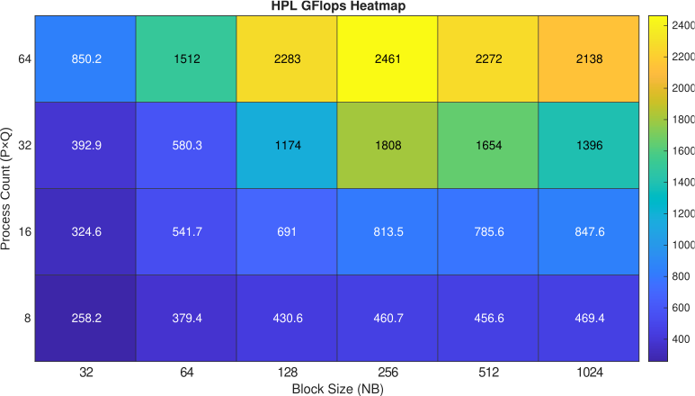
HPL on CPUs: Throughput Hotspot at NB = 256
Systematic sweep on Hopper (2 CPU nodes)
Varied NB = 32 → 1024, across 8–64 MPI processes
Measured GFLOPS for each configuration
Observed clear performance ridge around NB = 256
Why NB = 256 Performs Best
Fits cleanly in L3 cache working sets
Balances communication vs compute overhead
Larger blocks (NB ≥ 1024) overflow cache → thrashing + stalls
Key Result
Peak CPU throughput: 2.46 TFLOPS at NB = 256, 64 processes, 1:1 P×Q grid
This plateau appears consistently across CPUs, confirming that cache behavior—not raw FLOPs—dominates HPL scaling
Notes:
To understand HPL performance on CPUs, I performed a full parameter sweep on Hopper—varying block size NB from 32 up to 1024 and testing multiple MPI process counts. The heatmap revealed a very clear hotspot at NB = 256, regardless of process count."
"This makes sense architecturally: NB = 256 maintains a strong compute-to-communication ratio while still fitting efficiently in L3 cache. Once NB grows past 512, the working set spills, cache misses spike, and performance drops sharply. At NB = 1024, for example, we observed substantial L3 thrashing and reduced locality."
"With the optimal configuration—NB = 256 at 64 processes—we reached 2.46 TFLOPS, which aligns well with Hopper’s peak theoretical throughput given memory bandwidth and process grid constraints."
"This systematic tuning step is crucial because it identifies where the CPU architecture naturally wants to operate before we move on to the GPU-specific behavior.

Slide 8
HPL on H100 GPUs: High-Frequency GFLOPS Oscillations
Observed:
73.1 TFLOPS sustained
Rapid oscillations: ~70k ↔ 80k GFLOPS
Aligned with HPL algorithm phases
Why?
Trailing updates: compute-intensive → GFLOPS spike
Panel broadcasts: synchronization wait → GFLOPS dip
Key Insight
Even in dense LA, communication phases dominate overall performance.
Notes:
Noticed periodic oscillations from 70-80 TFLOPS. Why? initial thought was that there was serial starvation going on. (panel broadcast stalling GPU
I though the GPU was sitting idle waiting for the factorization and broadcast to finish but I wanted to dig deeper.

Slide 9
Kernel Jitter Analysis: Root Cause of HPL Oscillations
Nsight Systems Profiling Findings
The primary compute kernel (kernel_lds_pipeline) shows extreme execution-time variance
Coefficient of variation > 460% across iterations
Compute kernel jitter aligns precisely with GFLOPS peaks and valleys
Interpretation
During trailing updates, the compute kernel runs at full throughput → GFLOPS spike
During panel factorization + broadcast, GPU threads stall → GFLOPS dip
Jitter is a structural consequence of HPL’s alternating algorithmic phases
Key Insight
Performance oscillations originate from kernel-level synchronization behavior — not hardware instability or noise.
Notes:
I used Nsight systems to profile the GPUs during the run and see what was going on.
I expected to see gaps where the compute stream would end and the panel broadcast would start but that wasn’t the case.
So what was it?

Slide 10
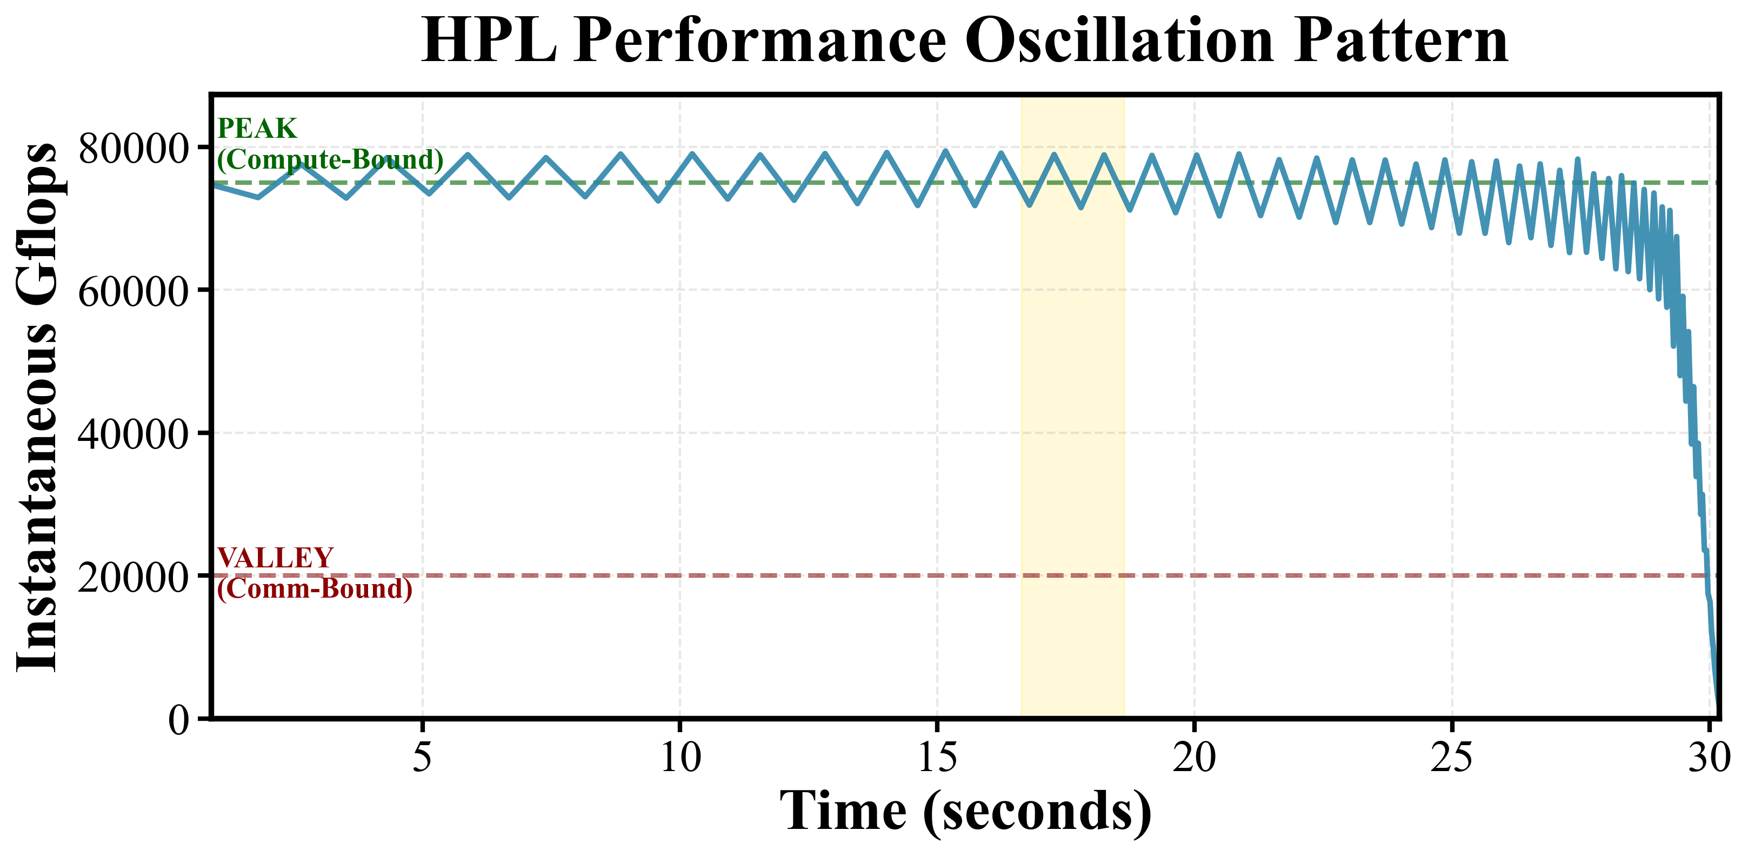
Notes:
Point out the peaks and valleys that I think line up with the stalling
Point out frequency and amplitude as time goes up

Slide 11
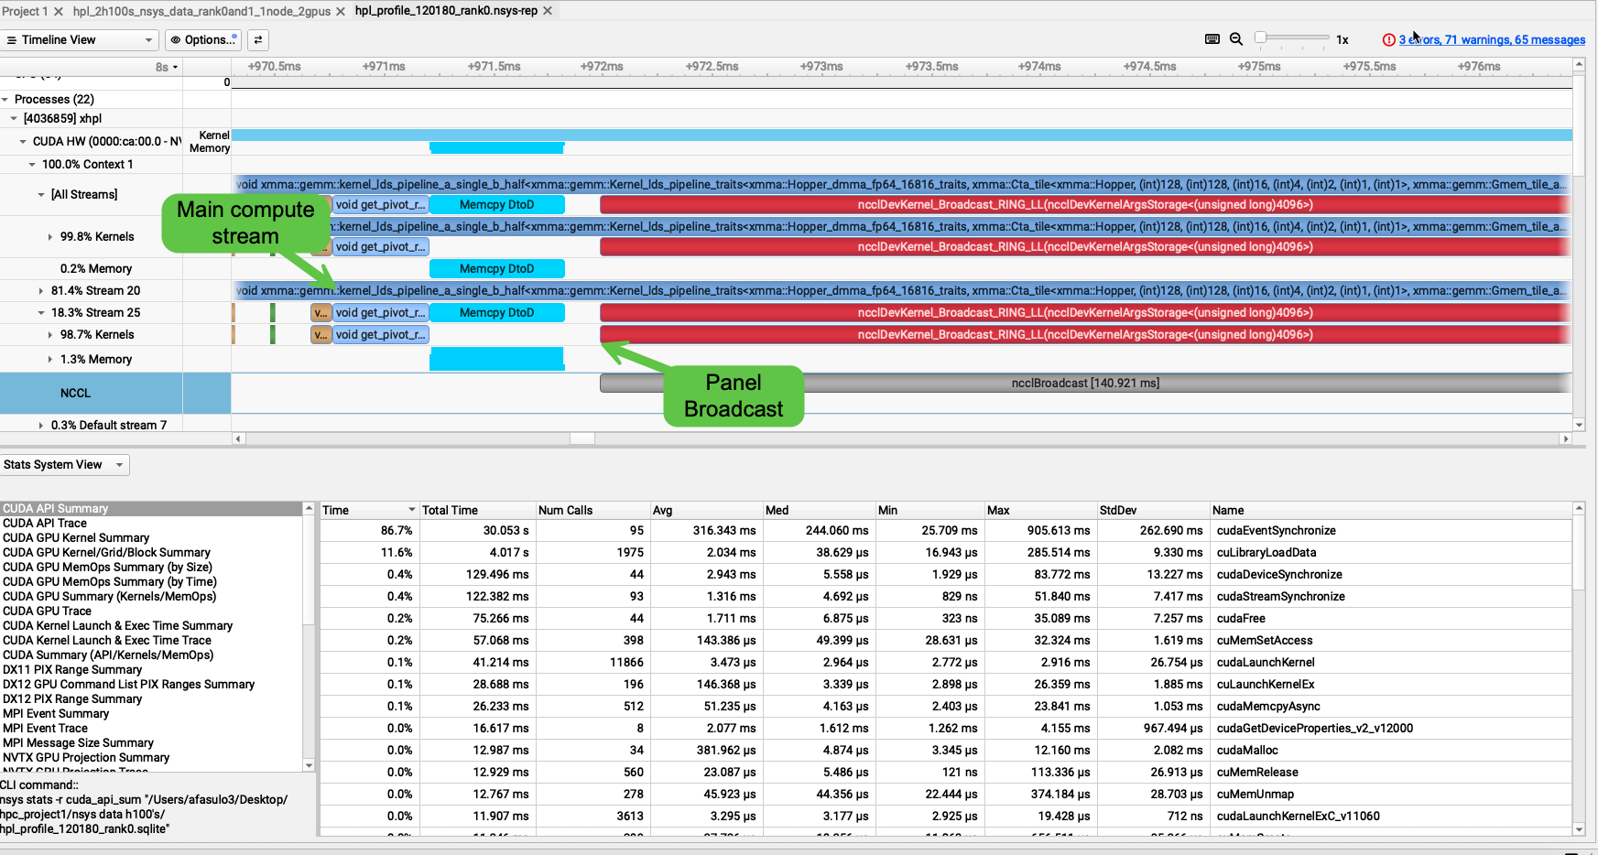



Notes:
Look at main compute stream and notice there are no gaps on stream 20. So is my theory still correct? After further investigation, it is.
The HPL implantation tries to keep the GPUs fed. Nvidia is aware of this and there is some special instruction to do this data pipelining.
So why still the oscillations?
The GPU isn’t idle it is just working on a smaller and less efficient chunk in the pipeline queue during the broadcast phase.
This smaller sub problem doesn’t saturate the GPU as efficiently as the large and fast trailing update portion.
I wanted to dig deeper and see what was happening in these kernels using Nsight compute, but I couldn’t because it is a security risk and on a shared system.

Slide 12
Why HPL Alone Isn’t Enough: Transitioning to HPCG
Limitations of HPL (Dense, Compute-Bound)
Optimistic benchmark: measures peak FLOP throughput
Dominated by dense GEMM with ideal locality
Communication pattern: predictable panel broadcasts
Not representative of LANL’s sparse, irregular physics workloads
Motivation for HPCG
Designed to mimic real application bottlenecks (SpVM)
Dominated by memory bandwidth and network behavior
Provides a lower-but-more-realistic view of system performance
Key Takeaway
HPL tells us how fast our hardware could be. HPCG tells us how fast it will be for real scientific workloads.
Notes:
HPL is optimistic, where HPCG is the truth. Sparse/irregular.
HPCG is a memory bound application where HPL is compute bound

Slide 13
HPCG Results Overview: Key Performance Findings
CPU Scaling
Strong scaling: sublinear due to communication
Weak scaling: near-linear GFLOPS growth
Behavior matches Amdahl/Gustafson predictions
GPU Scaling
For weak scaling (256³ per GPU):
571 → 1095 GFLOPS
96% efficiency
Key Insight
HPCG performance is tied to memory bandwidth and communication latency, not FLOPs.
Notes:
Saw sublinear strong scaling on CPU due to communication overhead
Weak scaling was near linear for CPU and GPU
HPCG is memory bound. So, let’s quickly verify that. Next slide

Slide 14
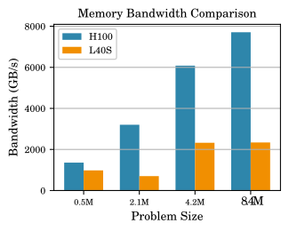
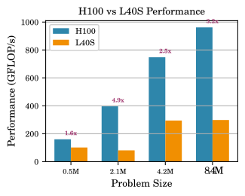
HPCG H100 Results
Result: H100 is 3.06× faster than L40S Memory Bandwidth: HBM3 = 7.7 TB/s vs. GDDR6 = 2.3 TB/s (3.3× higher)
Conclusion: HPCG performance correlates almost linearly with memory bandwidth.
Notes:
Small test on H100’s and L40S. 3x the memory, 3x the speedup.

Slide 15
Takeaways: Understanding Performance Across Architectures
HPL teaches us:
Compute-bound limits
Synchronization bottlenecks
GPU kernel behavior
HPCG teaches us:
Memory bandwidth is often the limiting factor
Communication patterns define scalability
Overall: Performance = interaction of algorithm + architecture + runtime environment.
Notes:
HPL shows us our limits when we are compute bound
HPCG shows us our memory bandwidth These help us inform scientists, build better systems, and be more efficient.

Slide 16
Closing
I’m excited about the opportunity to contribute to LANL’s HPC ecosystem — building tools, runtimes, and systems that make large-scale scientific computing faster, more predictable, and easier for researchers to use.
My goal is to do great work and make an impact on the team, contributing to LANL’s overall mission.
Notes:
Project wasn’t just about benchmarks and analyzing scaling laws.
I wanted to know why and how these systems work.
I was curious about something, and I wanted to know why and how. had a blast doing it.

